Slide 1


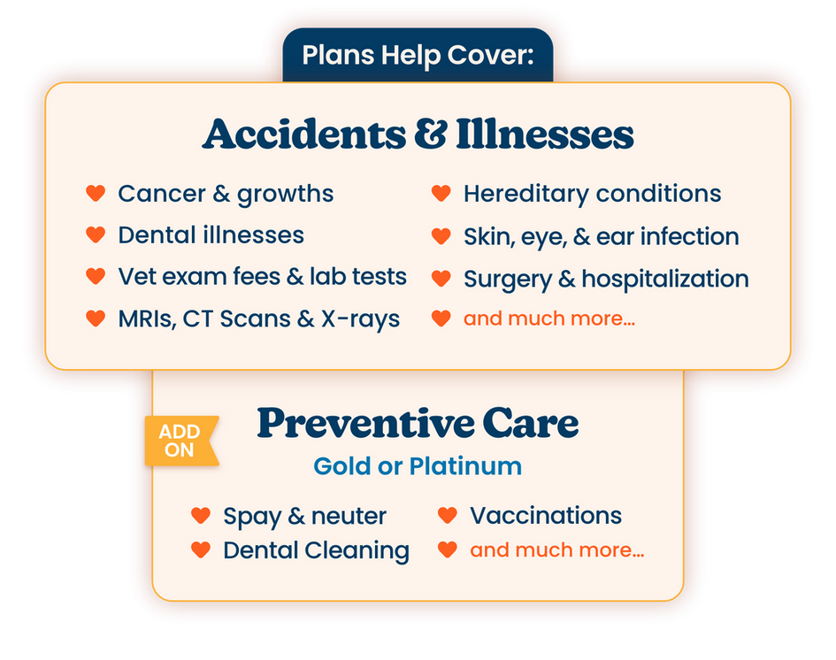







spotpet.link/ga
or call 888.343.2340
v

